Slide 1
Linux IRQ Affinity Example

Slide 2
Overview
This example will demonstrate how IRQ affinity within linux can be used with core isolation and core affinity to allow a collection of performance sensitive threads to run on core1 of the Cyclone V SoC Cortex A9 cluster with minimal interference and jitter from the activities occurring on core0. By using IRQ affinity we can ensure that threads running on core1 that might require some degree of light real time responsiveness to hardware events are able to achieve desirable response times. Other threads that are run on core1 may not have real time response requirements, but they will be allowed to utilize the unrequired processing cycles of core1 while the real time processing threads are idle and awaiting the next hardware event.

Slide 3
FPGA hardware design
The FPGA hardware for this example is illustrated by it’s Qsys system on the next slide. The system is trivial, there are only two substantial peripherals in the system, a System ID and an Interval Timer. The System ID simply allows our software environment to confirm that the proper hardware has been loaded into the FPGA and the Interval Timer allows us to generate a consistent periodic interrupt into the HPS GIC, and allows us to determine what the response time is of the software environment. The Interval Timer is clocked at a 100MHz frequency, and in this example it will be configured to generate a 100us interrupt event.

Slide 4
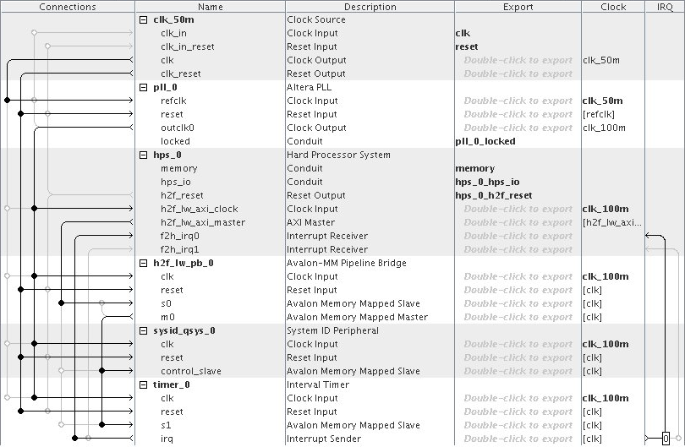
Qsys System in FPGA

Slide 5
Software Design – general
The software model that runs in this example begins with the linux 3.11 kernel configured to support nohz_full tickless kernel operation which can be invoked with boot arguments passed into the kernel at startup. The nohz_full configuration doesn’t necessarily provide any substantial benefit to this example but it was easy enough to provide for completeness. Once the kernel is running we load a custom module that provides the IRQ handler for our Interval Timer and a trivial driver to allow user space applications to sleep while waiting for the next interrupt. Then we load a custom application that measures all the jitter and latencies between each stage of the software interrupt responders running on core1 leveraging the custom driver operations. Then we run one additional program that performs jitter measurement for another thread running on core1.

Slide 6
Software Design – startup
When the example starts, the u-boot environment is used to pass the “isolcpus” argument into the kernel to isolate core1 from the SMP thread scheduler and allow us to manual launch specific threads onto core1. In the nohz_full case, the boot arguments also contain the required parameters to invoke the nohz_full environment. In both cases, the Cortex A9 boots up with the linux kernel running on core0 and core1 is idle.
Cortex A9 core0
linux kernel
Cortex A9 core1
idle

Slide 7
Software Design – IRQ affinity configuration
Once the kernel is up and running we configure the smp_affinity for the IRQ that is assigned to our hardware timer in the FPGA such that it runs on core1 rather than core0. This is done by setting the value of /proc/irq/X/smp_affinity.
Cortex A9 core0
linux kernel
Cortex A9 core1
idle

Slide 8
Software Design – load module/driver
Now we load a custom module that we created to register an interrupt handler for our interrupt and register a device driver with a read operation that can be called from user space applications to allow them to sleep until the next interrupt event. This leverages the wait_event_interruptible and wake_event_interruptible facilities. This module enables the Interval Timer hardware to begin producing interrupts.
Cortex A9 core0
linux kernel
example module/driver
Cortex A9 core1
IRQ handler

Slide 9
Software Design – run IRQ jitter application
Once the custom module/driver is installed, we startup our IRQ jitter monitor application which collects the statistics regarding how much jitter each stage of the IRQ forwarding process observes in the software flow. This application starts running on core0 and then spawns a thread with affinity to on core1 which performs the real time sensitive interaction with our custom driver.
Cortex A9 core0
linux kernel
example module/driver
IRQ jitter application (main)
Cortex A9 core1
IRQ handler
IRQ jitter application (thread)

Slide 10
Software Design – run max jitter application
Once the IRQ jitter application is running, we startup a second application to measure the jitter delay that another independent thread witnesses while it runs on core1 along with the IRQ handler and IRQ jitter application. This application is launched on core0 as well, and then spawns a monitoring thread onto core1.
Cortex A9 core0
linux kernel
example module/driver
IRQ jitter application (main)
max jitter application (main)
Cortex A9 core1
IRQ handler
IRQ jitter application (thread)
max jitter application (thread)

Slide 11
Software Design – add noise
Now that we have the core1 environment configured to run the IRQ handler and our jitter monitoring application threads, we turn on a number of noise generating operations to run on core0 so that the usage of core0 stays fully utilized.
Cortex A9 core0
linux kernel
example module/driver
IRQ jitter application (main)
max jitter application (main)
multiple noise creating applications
Cortex A9 core1
IRQ handler
IRQ jitter application (thread)
max jitter application (thread)

Slide 12
Software Design – data collection
With a busy linux system up and running on core0 and our data collection applications running on core1, we can allow the environment to collect statistics over a long period of time. We collect the latency that is observed from the IRQ hardware assertion to the IRQ handler execution, then we measure the time from the IRQ handler back to the driver read operation wake up, when the driver begins running again, and then we measure how long it takes for the application to resume execution after the driver read() operation returns following the IRQ wake up event. See these results on the next slide.
Cortex A9 core0
linux kernel
example module/driver
IRQ jitter application (main)
max jitter application (main)
multiple noise creating applications
Cortex A9 core1
IRQ handler
IRQ jitter application (thread)
max jitter application (thread)

Slide 13
Performance Results
The results on the right show the maximum and minimum timing that was captured during test execution. Items A thru E correspond to the events in the diagram illustrated below. The APP JITTER represents the jitter that is seen by the max jitter application that loads a thread onto core1 and continuously loops while reading the delay from a hardware timer.
 | ISOL |  | ISOL NOHZ_FULL
 | MIN | MAX | MIN | MAX
A | 1.9us | 45us | 1.8us | 65us
B | 6us | 74us | 10us | 80us
C | 1.6us | 60us | 1.6us | 60us
D | 100us | 100us | 100us | 100us
E | 59us | 142us | 32us | 162us
APP JITTER |  | 158us |  | 166us
IRQ Hardware Event
IRQ Handler Entry
Driver Wakeup
Application Active
IRQ Handler
Driver
Application
IRQ Handler
Driver
Application
IRQ
IRQ
LEGEND
A = IRQ Hardware Event to IRQ Handler Entry
B = IRQ Handler Entry to Driver Wakeup
C = Driver Wakeup to Application Active
D = IRQ Hardware Event reoccurrence
E = IRQ Handler Entry reoccurrence
A
B
C
D
E

Slide 14
Conclusion
What this example demonstrates is that multiple threads can be run on core1 of the Cortex A9 cluster using IRQ affinity, core isolation and core affinity to allow reasonably deterministic responses to real time hardware events. The worst case jitter that was witnessed by the example was about 162us for the real time sensitive threads which you can see in the IRQ handler reoccurrence jitter. The isolated jitter measurement thread also witnessed a 166us worst case jitter. So for a 100us event as we’ve demonstrated in this example, the amount of spare processing time on core1 is quite limited, but for events of 1ms or longer, substantial amounts of core1 processing time could be leveraged by other threads that crowd onto that core along with the real time sensitive threads.

